Slide 1
Application of Complex Functions in Mechanics
Instructor: 朱哲明 ( )
Zheming Zhu
College of Architecture and Environment, Sichuan University, China
and
Dept. of Civil Engineering, University of Toronto, Canada
Email: am.zhu@utoronto.ca; Tel:13882106617

Slide 2
Complex Functions
y
z = x + iy
S
W
x
Let S be an arbitrary set in the complex plane, if for each point z = x + iy of S, there corresponds to a complex number u (x, y) + iv (x, y), we say that a complex function W(z) has been defined on S. The value of the function is

Slide 3
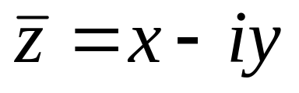
Complex Functions
at point z = x + iy, where u, v are real functions of the variables x, y. We note that a specific functional dependence on z rather than say
is not assumed by this notation.

Slide 4
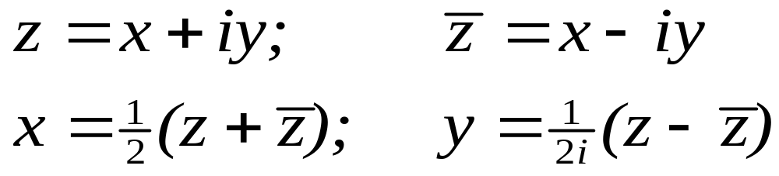
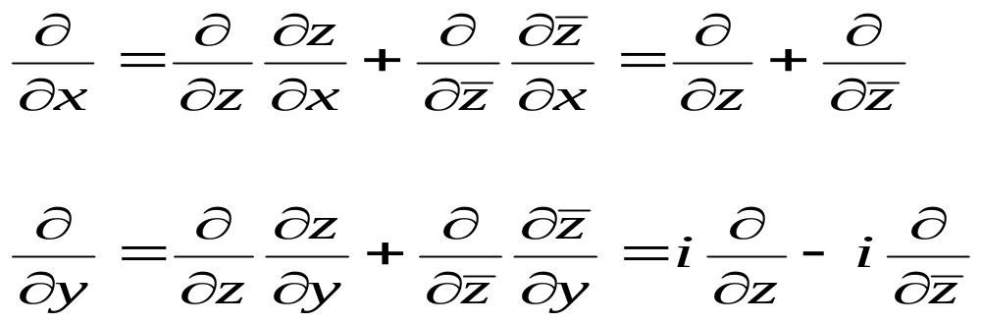
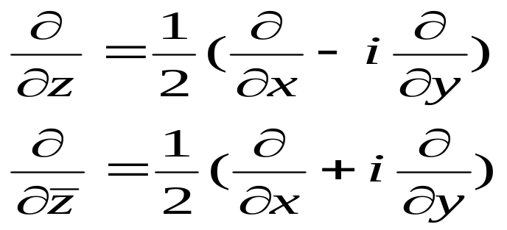
The general relation
and
We have

Slide 5
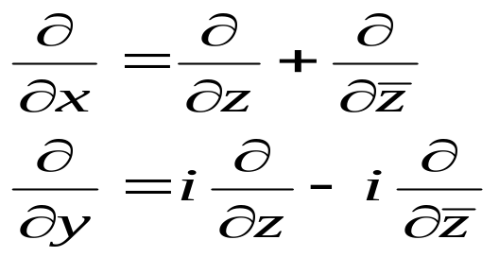
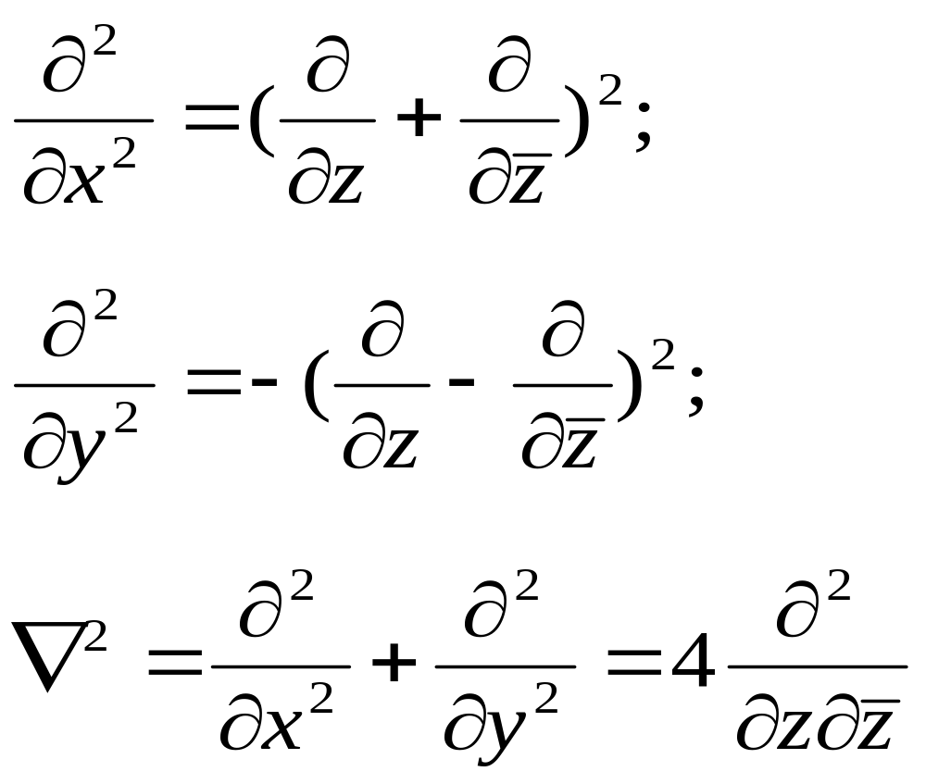
From
We have
and further

Slide 6
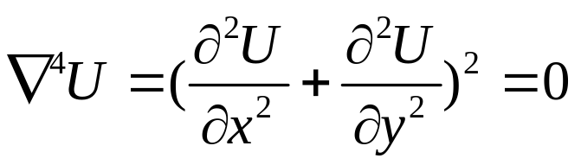
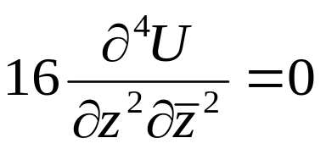
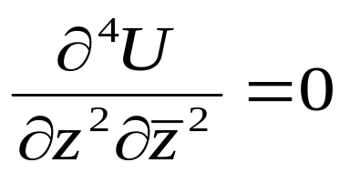
And the biharmonic equation
is changed to
i.e.
Integrating the biharmonic equation, we obtain

Slide 7
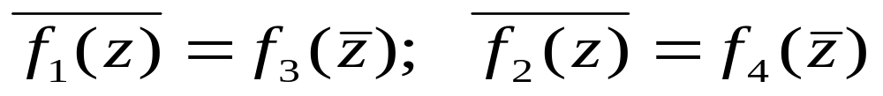
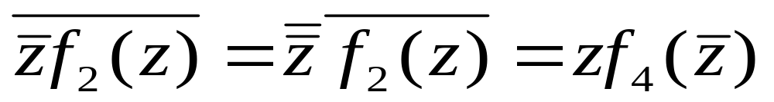
Integrating the biharmonic equation, we obtain
Because U(z) is a real function, therefore, the right-hand side functions of the above equation must be conjugate between two functions, i.e.

Slide 8
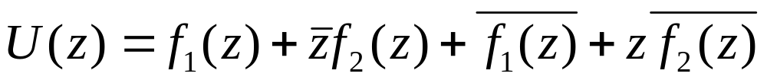
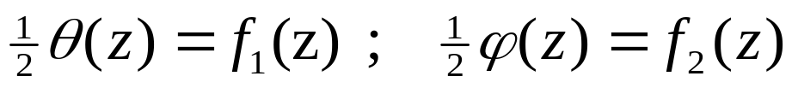
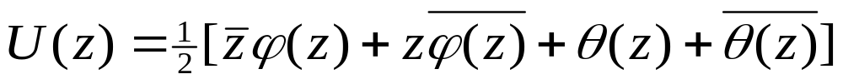
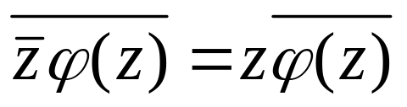
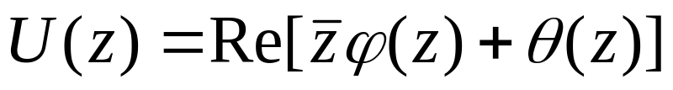
Let
then
It should be noted that
U(z) can be expressed in another form
Therefore, when the body force is a constant, stress function U(z) could be expressed in terms of two holomorphic functions

Slide 9
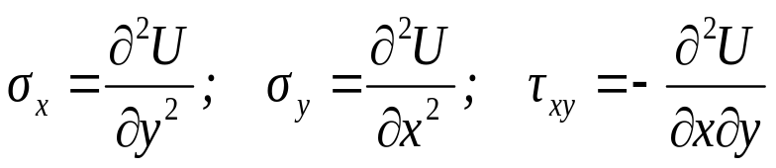
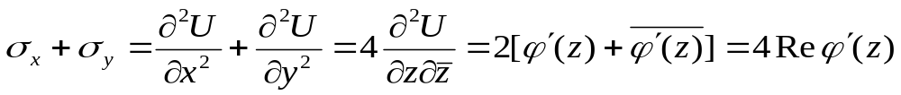
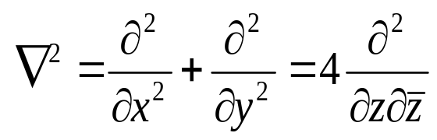
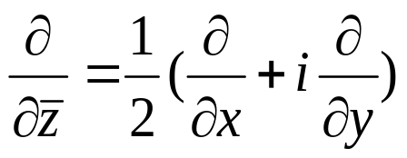
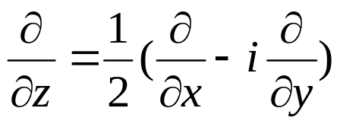
Stress expressed in terms of Complex Variables
If we don’t consider body force, then
three equations have been applied

Slide 10
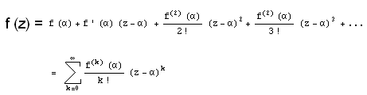
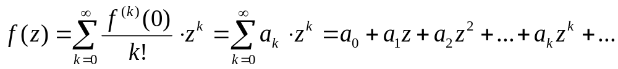
Taylor Series Representations
Definition
If is analytic at z =0, then the series
is called the Taylor series for f(z) centered at . When the
center is , the series is called the Maclaurin series for f(z).

Slide 11
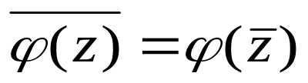
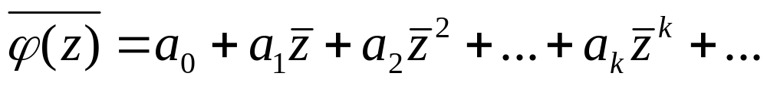
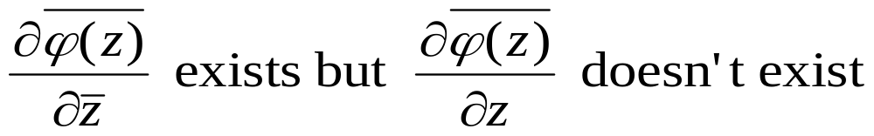
It can be seen that if the coefficient a_{k} are real constants, then
and

Slide 12
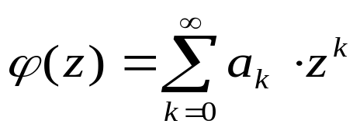
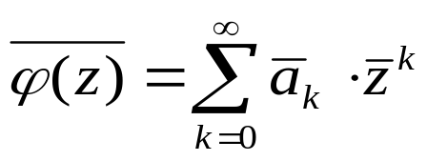
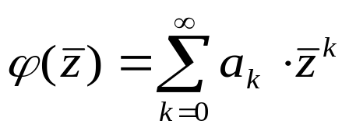
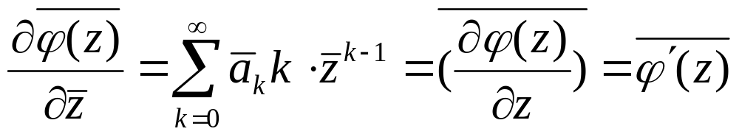
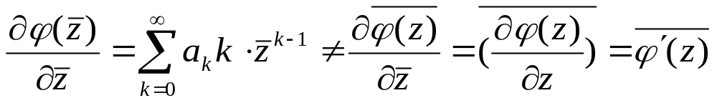
If a_{k} is a complex

Slide 13
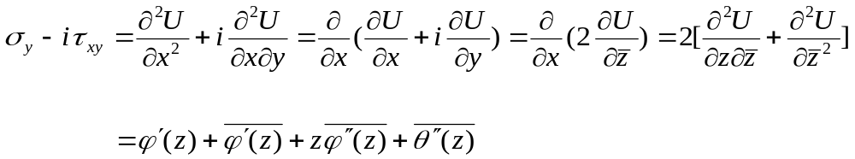
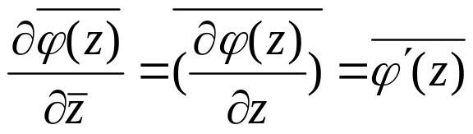
y
another equation is more useful for the study of fracture mechanics
It can be seen that if ϕ and θ are known, one can obtain the stresses.

Slide 14
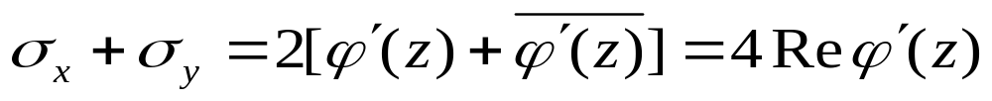
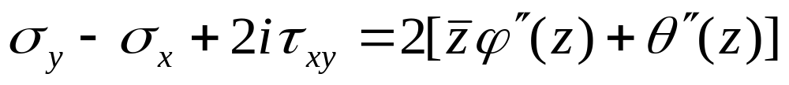
Stresses expressed in terms of complex stress function
y
It can be seen that if ϕ and θ are known, one can obtain the stresses.

Slide 15
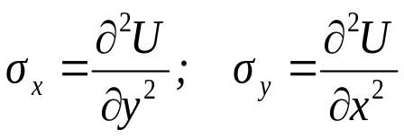
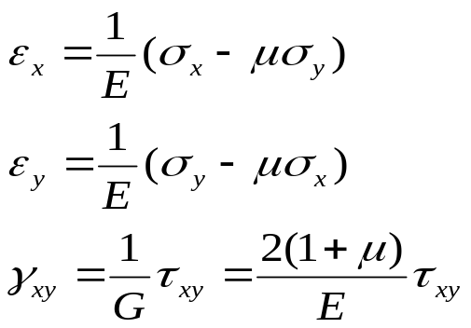

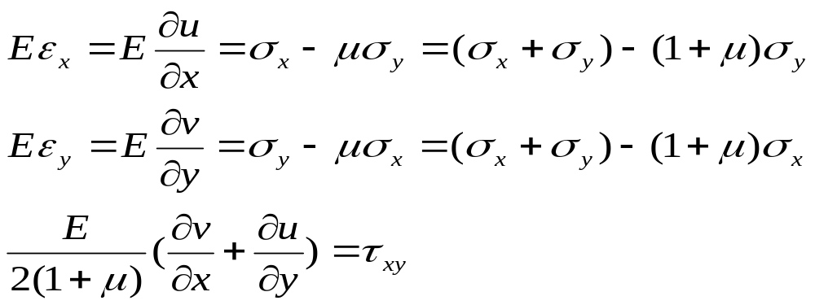
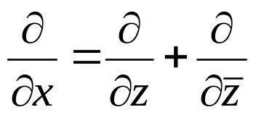
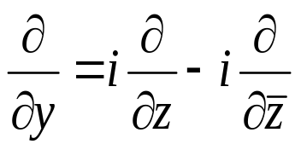
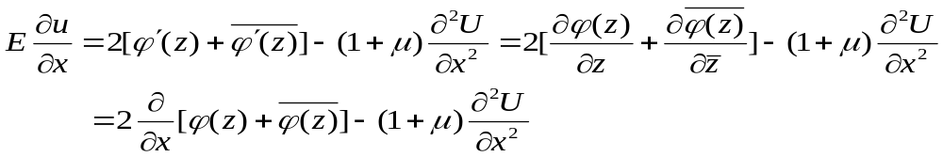
Displacements expressed in terms of Complex Variables
For plane stress problem, we have
So we have

Slide 16
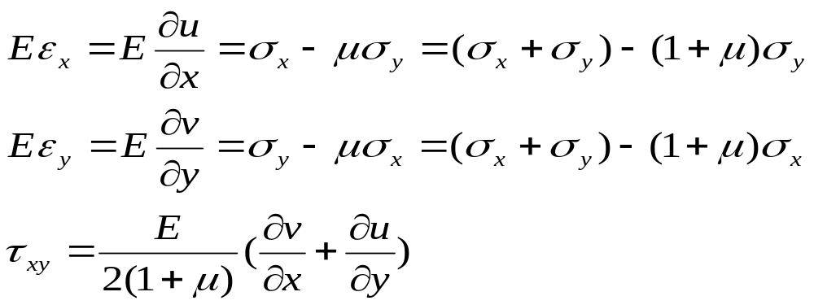
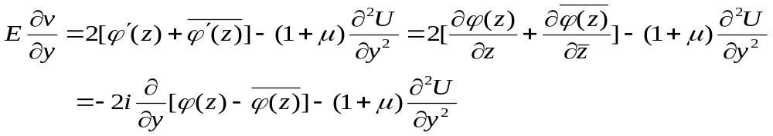
For plane stress problem, we have
So we have

Slide 17
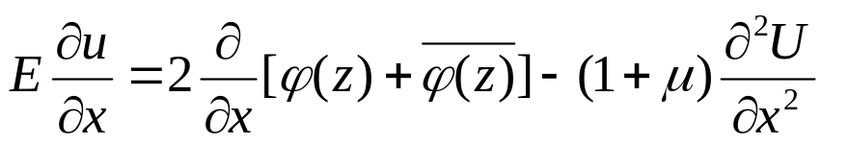
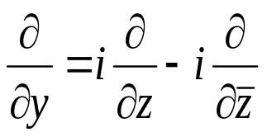
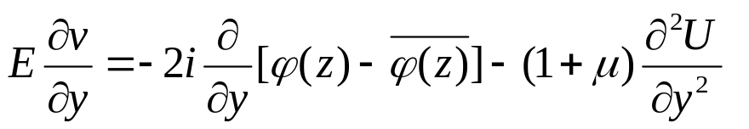
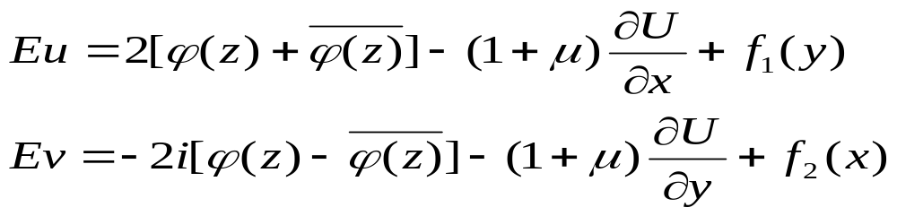
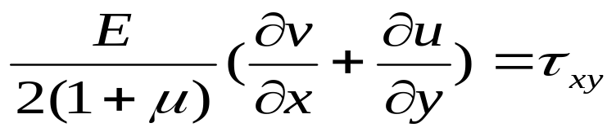
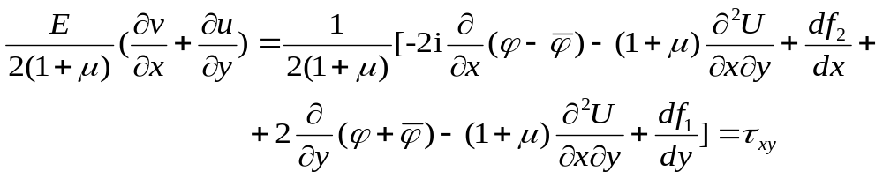
Integrating the above two equations, we have
Substituting the above two equations into
we have

Slide 18
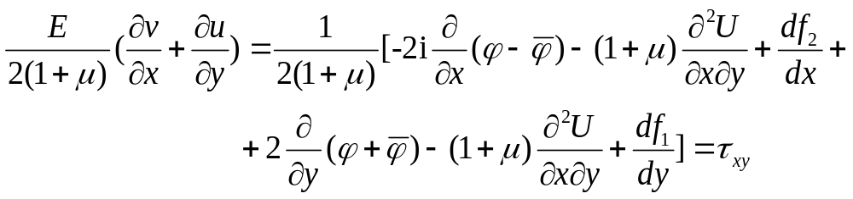



and considering
we have

Slide 19

f₁ and f₂ are uniform rotational motion with angular velocity ω, which is not considered, then
therefore

Slide 20





because
So, we have
or
It can be seen that if ϕ and θ are known, one can obtain u and v. It should be noted that the above equation is derived from the case of plane stress; for the plane strain problem, we only need change E to and μ to , and here

Slide 21




Stress expressed in terms of Complex Variables
Displacement expressed in terms of Complex Variables

